Slide 1
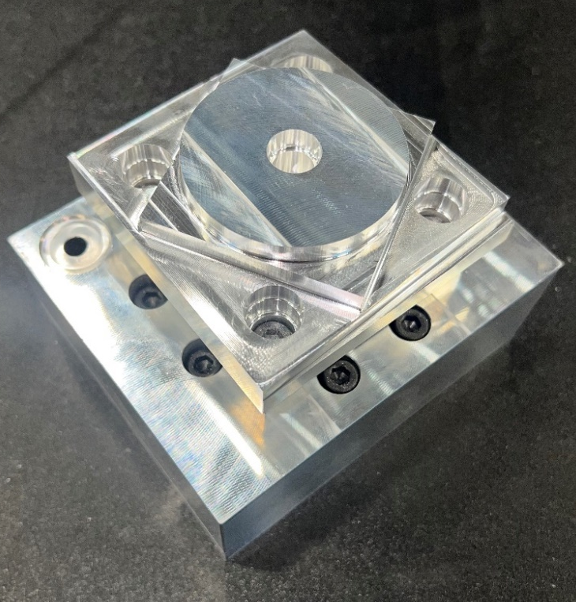
ISO 10791-7, M1_80
Circle diamond square cutting test
Purpose of test
Standardized method to evaluate positioning, contouring, and interpolation accuracy
Used to assess squareness, roundness, and straightness
Machining Parameters
Tool: 6.35 mm 3-flute bull nose endmill with zirconium nitride coating
Axial depth of cut: 6 mm
Radial depth of cut 0.508 mm
Feed rate: 1200 mm/min
Spindle speed: 19,200 rpm
80 mm
80 mm

Slide 2
ISO 10791-7, M1_80
Object | Characteristic | Tolerance [mm] | Desktop machine [mm] | Haas VF-4 [mm]
Central hole | Perpendicularity: C-A | 0.010 | 0.030 | 0.006
 | Cylindricity: C |  | 0.015 | 0.021
Square | Straightness: B | 0.005 | 0.008 | 0.002
 | Straightness: F |  | 0.011 | 0.004
 | Straightness: G |  | 0.006 | 0.003
 | Straightness: H |  | 0.006 | 0.002
 | Perpendicularity: H-B | 0.010 | 0.041 | 0.023
 | Perpendicularity: F-B |  | 0.062 | 0.005
 | Parallelism: G-B |  | 0.021 | 0.019
Diamond | Straightness: K | 0.005 | 0.016 | 0.002
 | Straightness: L |  | 0.018 | 0.002
 | Straightness: M |  | 0.015 | 0.003
 | Straightness: N |  | 0.022 | 0.003
 | Angularity: K-B | 0.010 | 0.023 | 0.003
 | Angularity: L-B |  | 0.036 | 0.007
 | Angularity: M-B |  | 0.026 | 0.003
 | Angularity: N-B |  | 0.025 | 0.004
Circle | Roundness: P | 0.015 | 0.031 | 0.010
 | Concentricity: P-C | 0.025 | 0.015 | 0.002
Sloping faces | Straightness: I | 0.005 | 0.012 | 0.011
 | Straightness: J |  | 0.011 | 0.002
 | Angularity: I-B | 0.010 | 0.014 | 0.016
 | Angularity: J-B |  | 0.057 | 0.007
Bored holes | Position: D1-C | 0.050 | 0.078 | 0.008
 | Position: D2-C |  | 0.027 | 0.003
 | Position: D3-C |  | 0.054 | 0.007
 | Position: D4-C |  | 0.037 | 0.007
 | Concentricity: E1-D1 | 0.020 | 0.048 | 0.007
 | Concentricity: E2-D2 |  | 0.014 | 0.002
 | Concentricity: E3-D3 |  | 0.036 | 0.003
 | Concentricity: E4-D4 |  | 0.011 | 0.007
Cutting test results
Parts measured using ZEISS Duramax coordinate measuring machine (CMM)
Over 10 points measured per feature
Desktop CNC mill compared versus same cutting test on Haas VF4
Desktop CNC mill struggled to meet ISO tolerances of 5-15 μm deviation
Sufficient accuracy for educational purposes
Average deviation of 20 μm from the Haas VF4 results

